Slide 2
Using your Web Browser,
Open this URL:
Click on the workshop you’re attending, and find:
1
http://mlhlocal.host/lhd-resources
2
Setup Instructions
The Code Samples
A demo project
A Workshop FAQ
These Workshop Slides
More Learning Resources
Notes:
What to Say:
Tell attendees we are going to check them in for the event
Once attendees check in, they will receive an email with the items listed on the slide
Attendees must check-in to get credit for attending this event
What to Do:
Confirm that everyone has checked in by asking participants to give you a signal when they receive the email.

Slide 3

Our Mission is to Empower Hackers.
65,000+
HACKERS
12,000+
PROJECTS CREATED
400+
CITIES
We hope you learn something awesome today!
Find more resources: http://mlh.io/
Notes:
What to Say:
Major League Hacking (MLH) events are meant to bring hackers together so they can learn, build, and share.
Give participants a brief overview of Major League Hacking (MLH).
Tell participants they can learn more at http://mlh.io/
Example Talking Points:
TODO
Through Localhost MLH is rethinking technology education to reflect how hackers actually learn and how fast the industry moves.
Here’s some quick facts about MLH:
Each year, MLH supports over 65,000 hackers around the world at events they facilitate
Those students create more than 12,000 amazing projects together
MLH is a global organization that empowers hackers in more than 400 cities and growing every day

Slide 4

Our unique expression of social good
Capital One is dedicated to providing opportunities and resources that will enable more people to succeed.
Through our Future Edge program, we’re investing in and collaborating with leading educational and community organizations across the U.S.—to help more people succeed in the 21st century.
We’re empowering families through financial literacy and affordable housing, helping individuals bridge the digital skills gap and showing small businesses how to harness technology to grow and compete.

Slide 5
What will you learn today?
1
How Python can be used to create web apps
2
Several useful Python libraries
3
How to create a chat experience in a web app
Notes:
What to Say:
Explain to participants what they will learn today
Learning is a core part of being a hacker and today they are going to learn something new
What to Do:
Get participants excited about the experience.

Slide 6
Why does this matter?
1
Many artificial intelligence projects are on the web. You want to be able to share your cool work with others!
2
Learning how to use third party libraries is a skill you'll use in any programming language.
3
Once you learn one programing language, you can learn any .
Notes:
What to Say:
Explain to participants what they will learn today
Learning is a core part of being a hacker and today they are going to learn something new
What to Do:
Get participants excited about the experience.

Slide 7
What do you remember from last time?
Discuss for a few minutes with someone around you.
Notes:
What to Say:
Read the slide.

Slide 8
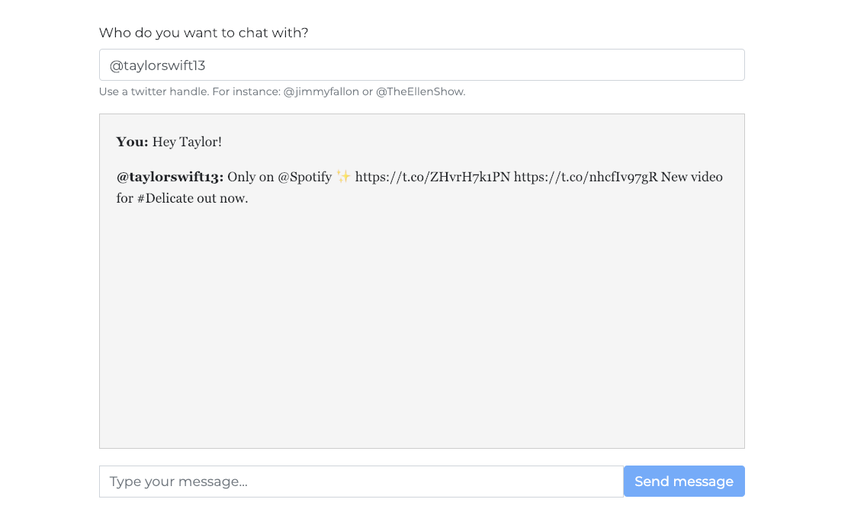
What are you going to build today?
You’re going to use your new Python skills to create a Chat Bot!
Give it a try by heading to the URL below:
https://mlhlocal.host/glitch-bot

Slide 9
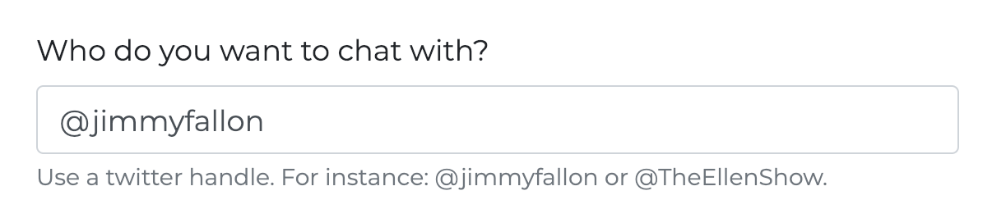
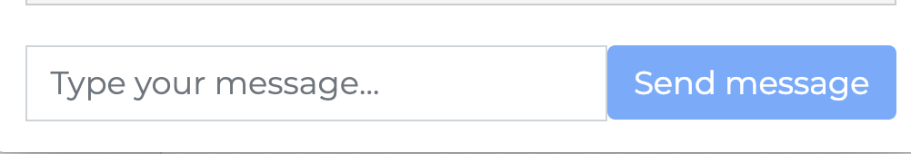
How does this work?
In the first box (called a text field), the user enters a person's Twitter name.
In the second box, the user enters a message.
The Twitter name and message are sent to the app.

Slide 10


How does this work?
The app uses a library called BeautifulSoup to scrape up to 10,000 Tweets from a user using the Twitter API
The app uses a Python library called Flask to handle the requests and responses.
Then, the app randomly returns one of the Tweets to you!

Slide 11
What's web scraping?
Lots of information on the internet is text. Python has some libraries that you can use to easily scrape that text, or copy it from the website into a file.
Most libraries have documentation to help you learn how to use the library.
Key Term
Scrape: To collect all of the data (code) from a webpage

Slide 12
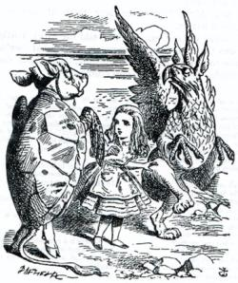
What's web scraping?
You can see the Beautiful Soup documentation here: mlhlocal.host/beautiful-soup
You won't need the documentation today, but you should get used to reading and learning from documentation. It's a very important skill for all developers to have!

Slide 13

How are you going to rebuild it?
These are the steps you'll need to take:
You'll make your own copy of the code on Glitch.
You'll read through the code and discuss it with others.
You'll write some missing Python code.
Then, you'll recap and take a quiz!

Slide 14
That may sound like a lot of steps. Part of coding/programming is learning how all the different tools work and how they work together. We know you can do it!
Notes:
What to Say:
Read the slide.

Slide 15

Some things to keep in mind
Writing code is tricky. Pay attention to the following best practices!
The majority of the time, when something isn't working with your code, it's as simple as a typo. Make sure that you've typed everything correctly before moving on to other debugging techniques.
Glitch has a really cool rewind feature. If your code was working before, and it's not working now, use the rewind feature to back up.
It's okay to make mistakes! You're learning something new, and that's really tricky.
Notes:
Special thanks to https://medium.com/@Alexander_H/scraping-wikipedia-with-python-8000fc9c9e6c for inspiration!

Slide 16
Let's get started!
Notes:
What to Say:
Read the slide.

Slide 18



What Python Skills Did We Learn Last Time?
Variables: variables in programming are a lot like variables in math! They store information for us.
Loops: loops are a structure your program can use to perform the same task multiple times (rather than coding it out by hand every time).
Functions: a structure you can use in your program to reuse bits of code throughout the program
Libraries: a collection of functions someone wrote, which we can import into our own programs to use.

Slide 19


What Will You Learn Today?
You will learn the following Python skills so that you can clean some data.
Regular expressions – a programming concept used to work with text
Imports – using data or functions from other sources (like libraries or other files in our project)
Key Term
Data cleaning: using code to remove or edit parts of data that we don't want, to standardize it and make it easier to work with

Slide 20
The best way to learn to code is to CODE, not to read about it, so let's dive in!
Notes:
What to Say:
Read the slide.

Slide 22
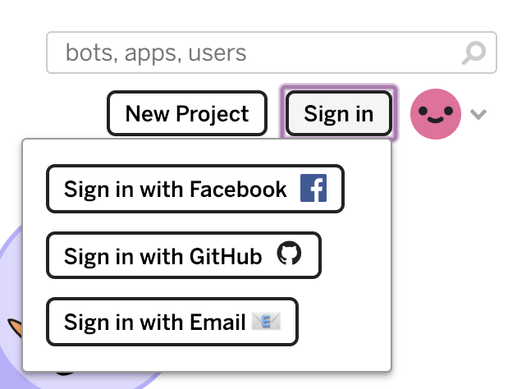
Glitch
Please note! Signing in is optional, but it lets you save your code. Instructions are below.
Navigate to this URL.
Click Sign in. Choose how you want to log in.
glitch.com

Slide 23
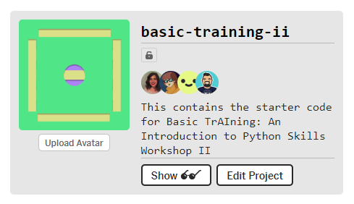
Get the code
https://mlhlocal.host/glitch-python-ii
Navigate to the URL above.
Click Edit Project.

Slide 24
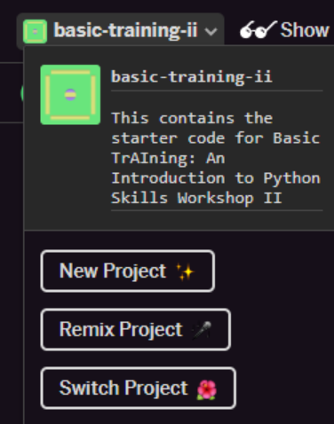
Get the code
Click the basic-training-ii title on the top left of the screen
Then click Remix Project to create a copy of the code.

Slide 25
Now you have all the code you need to complete this workshop! Let's explore it.
Notes:
What to Say:
Read the slide.

Slide 26
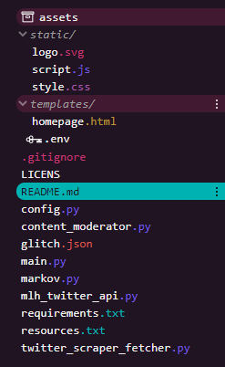
What files are in this project?
logo.svg is the logo image
script.js is a JavaScript file that adds the bot responses to the center box on the webpage
style.css is the file that styles our webpage
homepage.html is the file that provides the structure of our webpage, such as the text fields where the user types their question
config.py is a file that tells Glitch how to run our app

Slide 27
What files are in this project?
main.py is a Python file that handles the requests and responses for our file. When a user types a message into the chat box, they are requesting the bot to send a message back.
twitter_scraper_fetcher.py is a file that scrapes Tweets. We'll be working with this one today!
README.md is a file that tells you about the project. The words inside of it are not code.
requirements.txt is a file that tells our project what libraries and frameworks that it needs to work.
resources.md contains all sorts of resources to keep learning later!

Slide 29
Now that you understand the project, dive in!
Notes:
What to Say:
Read the slide.

Slide 30
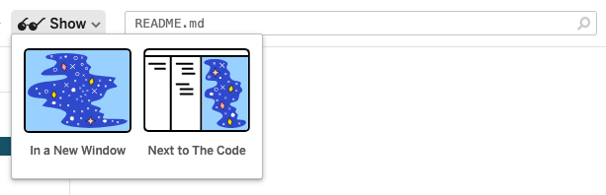
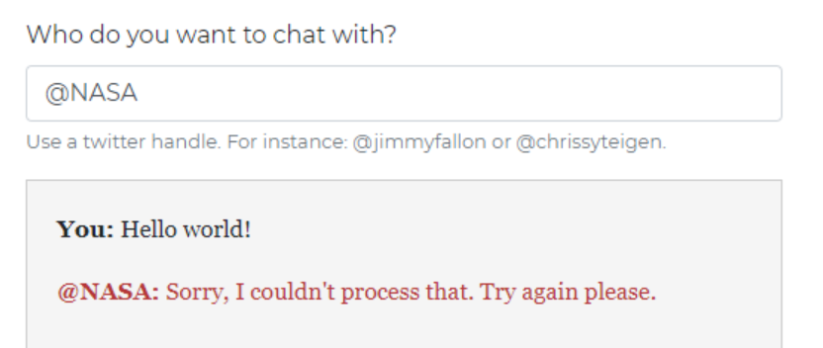
Running the Glitch App
You can run the app by clicking Show in the top bar.
But if we try to use the app, we get an error message - we have to write some functions first!
Let’s get started!

Slide 31
.env Credentials
The .env file contains the Environment Credentials we need to run the application.
Open up the .env file and add the following details so that it looks like this:
1
2
3
4
5
MLH_TWITTER_API=https://localhost-python-abstraction.glitch.me
TWITTER_FETCHER=scraper
FLASK_ENV=development
FLASK_PORT=500
Notes:
Bonus description of Credentials: They are variables we use for authentication. For example, your username and password are Login Credentials. Environment Credentials are things that the application needs in order to run - like which Port we’re using.

Slide 32
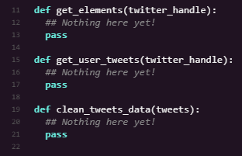
Let’s write some code!
Open twitter_scraper_fetcher.py.
Notice that we have three empty functions - this is what where you are going to write some code.
get_elements() returns all the data from a Twitter account.
get_user_tweets() extracts the tweet data from the elements data.
clean_tweets_data() removes emojis, URLs, and other data we don’t want from the tweets.

Slide 33
Write Code: get_elements()
We’re going to use libraries called Requests and BeautifulSoup which can scrape data from websites for us.
11
12
13
def get_elements(twitter_handle):
url = TWITTER_URL + twitter_handle
This function has one parameter, twitter_handle, which represents a twitter username.
Line 12: We create a full twitter URL. This works by adding two Strings together: The Twitter URL on Line 8, and a twitter handle passed into the function as a parameter.
For example, TWITTER_URL + ‘nasa’ would return http://twitter.com/nasa.
Notes:
Note: the ‘pass’ line is a placeholder which allows the function to be non-empty. We delete it when we’re adding in these lines of code as this is the replacement.

Slide 34
Write Code: get_elements()
We’re going to use libraries called Requests and BeautifulSoup which can scrape data from websites for us.
11
12
13
14
15
def get_elements(twitter_handle):
url = TWITTER_URL + twitter_handle
response = requests.get(url)
html = response.content
Line 13: We use the Requests library to return all the HTML (data) from that webpage - the URL we created on Line 12.
Line 14: From the response we receive from the webpage, we just want the content.

Slide 35
Write Code: get_elements()
Add a few more lines to the function.
11
12
13
14
15
16
17
def get_elements(twitter_handle):
url = TWITTER_URL + twitter_handle
response = requests.get(url)
html = response.content
soup = BeautifulSoup(html, features="html.parser")
Line 16: We create a variable called soup which is a new BeautifulSoup object. We create it and say that we want it to analyse the HTML content we created on Line 14.

Slide 36
Write Code: get_elements()
Add a few more lines to the function.
11
12
13
14
15
16
17
18
19
20
21
def get_elements(twitter_handle):
url = TWITTER_URL + twitter_handle
response = requests.get(url)
html = response.content
soup = BeautifulSoup(html, features="html.parser")
return soup.find_all(
CONTENT_CONTAINER_TAGS, attrs={"class": CONTENT_CLASS_NAME})
Line 18: We put our soup variable to use and ask it to find all of the relevant information we need, and return it.
Notes:
Adding lines 18-20 of code.
The return line is on one line - it’s condensed here due to space constraints.

Slide 37
Write Code: get_elements()
What’s happening?
Line 16: We create a BeautifulSoup object. The BeautifulSoup library makes it easy to parse large amounts of data.
Lines 18-20: We use the object to search through the HTML and give us all the data that contains tweets.
Key Term
Parse: The process of analysing large sets of data with algorithms.
Notes:
Note: Line 10 can be all on a single line, it’s split across multiple lines here to save space.
Watch out for the order of the ( and { tags on line 10.

Slide 38
Write code: get_user_tweets()
Let’s move onto the next function: get_user_tweets(). This will return a list of a Twitter user’s recent tweets.
Add the following code to the function:
20
21
22
23
def get_user_tweets(twitter_handle):
elements = get_elements(twitter_handle)
Line 20: Our function has one parameter - the user’s twitter handle.
Line 21: We call the function we wrote above, get_elements()!

Slide 39
Write code: get_user_tweets()
20
21
22
23
def get_user_tweets(twitter_handle):
elements = get_elements(twitter_handle)
tweets = []
Line 22: We create an empty list called tweets - this is going to contain a list of tweets we extract using BeautifulSoup.

Slide 40
Write code: get_user_tweets()
Add a few more lines to the get_user_tweets() function:
20
21
22
23
24
25
26
def get_user_tweets(twitter_handle):
elements = get_elements(twitter_handle)
tweets = []
for post in elements:
for text in post.contents:
Lines 24-25: We loop over each item in the elements list.
Then for each of those items, we loop over all of the contents.
Notes:
Watch out for the indentation here: we have a loop inside a loop!

Slide 41
Write code: get_user_tweets()
20
21
22
23
24
25
26
27
28
29
def get_user_tweets(twitter_handle):
elements = get_elements(twitter_handle)
tweets = []
for post in elements:
for text in post.contents:
# check if line contains real text
if text.string not in EMPTY_ITEMS:
tweets.append(text.string)
return tweets
Line 27: If the text contains some data (is not empty), add it to our list of Tweets.
Line 29: Return the list of Tweets.
Notes:
Watch out for the indentation here: we have a loop inside a loop!

Slide 42

Review Code: get_user_tweets()
What’s happening?
Line 26-30: We have a loop inside a loop!
What we are doing is looping through all of the HTML elements, and checking the text to see if they contain information.
If they do (if not in EMPTY_ITEMS), we append (add) it to our list of tweets.
Line 31: We return the list of tweets that we have created.
Notes:
Watch out for the indentation here: we have a loop inside a loop!

Slide 43
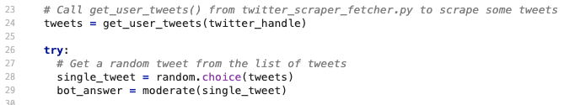
Review: main.py
Open up main.py and take a look at Lines 23-27:
Line 24: We call the function we wrote in twitter_scraper_fetcher.py.
Line 27: We use the Random library to return a single random tweet from the list of tweets.

Slide 44
Let’s run our app and see how it looks!
Notes:
What to Say:
Read the slide.

Slide 45
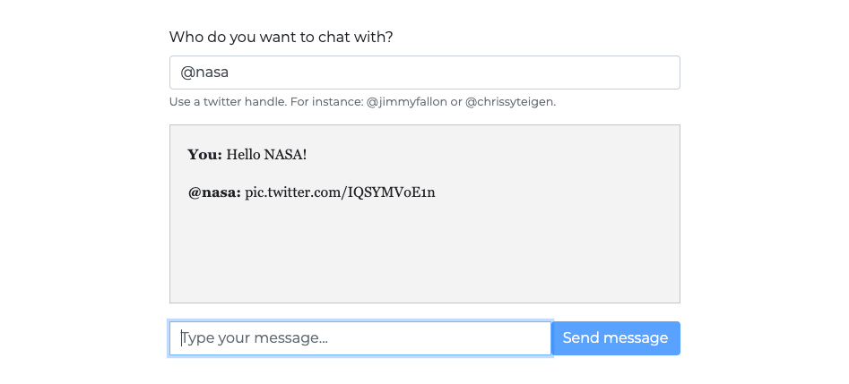
Running the App
Click on Show at the top of the Glitch window.
Try typing a message to your favourite Twitter user and see what happens!
Notes:
What if nothing happens?
Something may have gone wrong under the hood. See if any errors are occuring by clicking Tools > Logs > Console in the Glitch Window. If there’s an error on the code, the Console will hopefully tell you which file and line it is occuring in.

Slide 46
Awesome!
Now, we’ve got one more function to add...
Notes:
What to Say:
Read the slide.

Slide 47

Regular Expressions
We’re going to clean up our tweets with a powerful programming tool called Regular Expressions.
A Regular Expression (or regex) is a sequence of characters which create a search pattern.
We can use it to remove all data that doesn’t match our regex search criteria.
How do they work?

Slide 48
Regular Expressions: Example
First we create a regex pattern:
url_pattern = re.compile(r"http\S+", re.DOTALL)
re is the Python regex library.
r”http\S+” means: create a regular expression (r) that finds text that starts with http and is followed by any length of string (\S+).
re.DOTALL means apply this to everything, including new lines.

Slide 49
Regular Expressions: Example
Then, we can use it to replace and remove text that contains that search pattern.
example_tweet = “check out this URL! https://myamazingURL.com”
text_without_url = url_pattern.sub(r””, example_tweet)
We use the sub (substitute) function to replace any text that matches our search pattern with nothing (“” - an empty string).
The variable text_without_url would then equal:
“check out this URL!”

Slide 50
Regular Expressions: Example
Regular Expressions are tricky!
We won’t ask you to write some search patterns from scratch - we’ll let you know which ones to use.
Our regular expressions will remove URLs, emojis, and other data we don’t want to display.

Slide 51
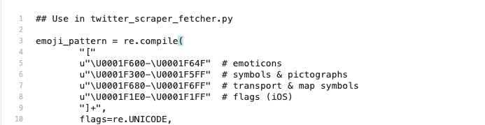

Write Code: twitter_scraper_fetcher.py
Open resources.txt:
Copy lines 3 through 11.
These are some regular expressions which will search for ranges of Unicode characters that are emojis.
For example, the Unicode character U0001F600 is the code representation of the grinning emoji!

Slide 52
Write Code: clean_tweets_data()
We’re going to add this to our final function, clean_tweets_data().
Copy the regex and add it to the function:
29
30
31
32
33
34
35
36
37
38
def clean_tweets_data(tweets):
emoji_pattern = re.compile(
"["
u"\U0001F600-\U0001F64F" # emoticons
u"\U0001F300-\U0001F5FF" # symbols & pictographs
u"\U0001F680-\U0001F6FF" # transport & map symbols
u"\U0001F1E0-\U0001F1FF" # flags (iOS)
"]+",
flags=re.UNICODE,
)

Slide 53
Write Code: clean_tweets_data()
Now, we’re going to add a few more regex to remove URLs and Tweets that mention other users:
39
40
41
42
43
44
45
46
47
48
url_pattern = re.compile(r"http\S+", re.DOTALL)
mentions_pattern = re.compile(r"@\S+", re.DOTALL)
cleaned_tweets = []
for tweet in tweets:
text_without_emoji = emoji_pattern.sub(r"", tweet)
text_without_url = url_pattern.sub(r"", text_without_emoji)
cleaned_tweets.append(mentions_pattern.sub(r"", text_without_url))
return cleaned_tweets
Lines 43-46: We apply all of our regex to each tweet in our list.
Line 48: Returns our newly cleaned tweets!

Slide 54
Review: clean_tweets_data()
39
40
41
42
43
44
45
46
47
48
49
50
51
52
53
54
55
56
57
58
def clean_tweets_data(tweets):
emoji_pattern = re.compile(
"["
u"\U0001F600-\U0001F64F" # emoticons
u"\U0001F300-\U0001F5FF" # symbols & pictographs
u"\U0001F680-\U0001F6FF" # transport & map symbols
u"\U0001F1E0-\U0001F1FF" # flags (iOS)
"]+",
flags=re.UNICODE,
)
url_pattern = re.compile(r"http\S+", re.DOTALL)
mentions_pattern = re.compile(r"@\S+", re.DOTALL)
cleaned_tweets = []
for tweet in tweets:
text_without_emoji = emoji_pattern.sub(r"", tweet)
text_without_url = url_pattern.sub(r"", text_without_emoji)
cleaned_tweets.append(mentions_pattern.sub(r"", text_without_url))
return cleaned_tweets
Notes:
The function in full, for reference

Slide 55
What did you just do?
You created a new function that will remove all sorts of unnecessary characters from our Tweets.
Notes:
What to Say:
Read the slide.

Slide 56
What do you need to do after you create a new function?
You need to call it!
Notes:
What to Say:
Read the slide.

Slide 57
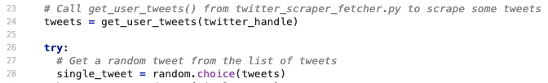
Challenge: main.py
Head back to the main.py file, where we will be calling our new clean_tweets_data() function.
Challenge: can you work out where to put our new clean_tweets_data() function?
Give it a try - the answer is on the next slide!

Slide 58
Solution: main.py
We have two changes to make:
24
25
26
27
28
29
30
Tweets = get_user_tweets(twitter_handle)
try:
# Get a random tweet from the list of tweets
cleaned_tweets = clean_tweets_data(tweets)
single_tweet = random.choice(cleaned_tweets)
bot_answer = moderate(single_tweet)
Firstly we need to call the function on Line 26.
Then, we need to select a random tweet from our new list of cleaned tweets, so we change the random.choice parameter to our cleaned_tweets list on Line 28.
Notes:
An alternate solution is to directly call the function within the random choice, e.g. random.choice(clean_tweets_data(tweets)).

Slide 59
Code Review: main.py
Let’s take a look at the rest of the main.py and see how it returns a tweet to the user.
17
18
19
20
21
# Chat API - WebSocket
@socketio.on("send question")
def generate_message(body, methods=["POST"]):
question = body["message"]
twitter_handle = body["username"]
Lines 17-20: When a user enters a question on our web page, save their message in a variable called question and save the twitter_handle of the person they want to talk to.

Slide 60
Code Review: main.py
17
18
19
20
21
22
23
24
# Chat API - WebSocket
@socketio.on("send question")
def generate_message(body, methods=["POST"]):
question = body["message"]
twitter_handle = body["username"]
# Chat API - WebSocket
Tweets = get_user_tweets(twitter_handle)
Lines 17-20: When a user enters a question on our web page, save their message in a variable called question and save the twitter_handle of the person they want to talk to.
Line 24: Call the get_user_tweets() function from twitter_scraper_fetcher.py and pass it the twitter_handle of the person we want to talk to. Save the response to a value called tweets.

Slide 61
Code Review: main.py
25
26
27
28
29
30
31
31
32
try:
# Get a random tweet from the list of tweets
cleaned_tweets = clean_tweets_data(tweets)
single_tweet = random.choice(cleaned_tweets)
bot_answer = moderate(single_tweet)
# Send the answer to the app, to display to the user
answer = {"username": twitter_handle, "message": bot_answer}
socketio.emit("bot answer", answer)
Lines 25-31: This is called a try block. The program will first attempt to do the code inside of this block, and if it doesn't work it will go to the except block below.
Line 27: Use the .choice() method from the random library to select one random tweet. Save it to a variable called cleaned_tweets.

Slide 62
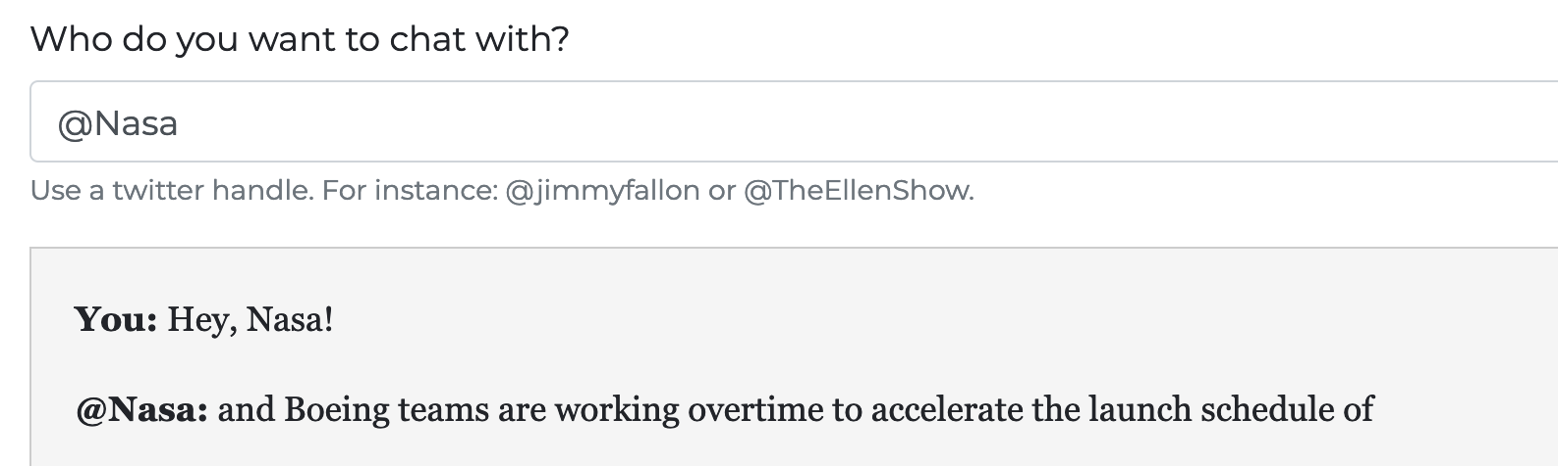
Code Review: main.py
29
30
31
# Send the answer to the app, to display to the user
answer = {"username": twitter_handle, "message": bot_answer}socketio.emit("bot answer", answer)
Line 30: Save the twitter_handle and bot_answer to a dictionary called answer.
Line 31: Send the answer to the user! That's how we get this:

Slide 63

Code Review: main.py
answer
twitter_handle
bot_answer
25
26
27
28
29
30
single_tweet = random.choice(cleaned_tweets)
bot_answer = moderate(single_tweet)
# Send the answer to the app, to display to the user
answer = {"username": twitter_handle, "message": bot_answer}
socketio.emit("bot answer", answer)

Slide 64
Code Review: main.py
32
33
34
35
36
except:
bot_answer = "Sorry, I couldn't process that. Try again please."
socketio.emit("error", {"username": twitter_handle, "message": bot_answer})
Lines 32-34: This is called an except block. If the code in the try block doesn't work, the program will send this error message to the user. You might remember this error message from the first time you ran the app, right?

Slide 65
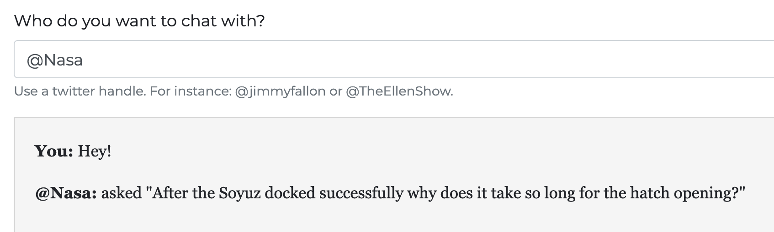
Try the app!
Click Show and try your app now!

Slide 66
What changed?
Now, your bot returns something a lot more like a sentence, rather than random emojis and @mentions.
Notes:
What to Say:
Read the slide.

Slide 67
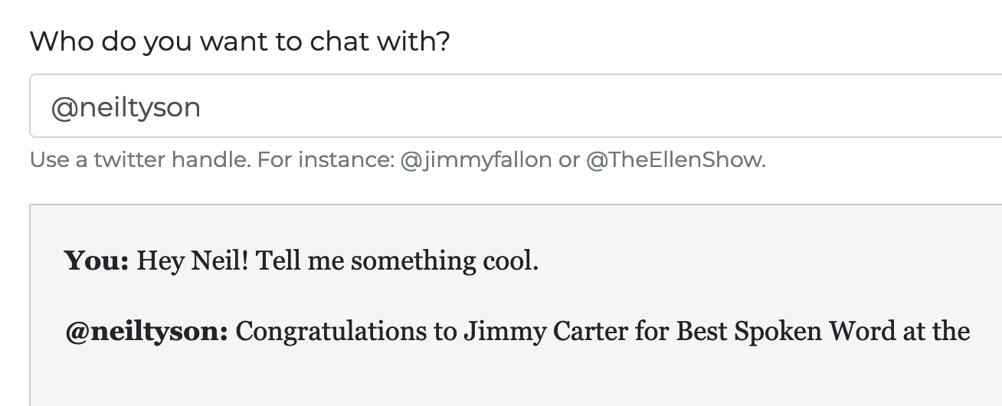
What next?
In the next workshop, we're going to incorporate artificial intelligence (AI) so that our app actually responds to our message, rather than just returning a random Tweet!

Slide 69
Let's Recap
What did you learn:
Python is a programming language you can use for many things.
1
2
Regular expressions are used to clean data.
3
Python tools you can use include imports, returns, and try/except blocks.

Slide 70
What did you learn today?
We created a fun quiz to test your knowledge and see what you learned from this workshop.
http://mlhlocal.host/quiz
Notes:
What to Say:
Read the slide.
What to Do:
Get participants excited about taking the quiz. Encourage them all to take it, and pass out stickers to participants who earn 100s. Also encourage participants to take the survey - let them know that Localhost takes their feedback very seriously and we use their feedback to make the workshop better for future participants.

Slide 72
Next Steps
Where to go from here...
There is a lot of code in this app that we didn't get to review. Try to read it and understand it on your own!
1
2
Check out codecademy.com's free Python lessons.
3
Take the third workshop!

Slide 73
v.0.0.1

